Slide 1
School Intervention database design
Alexandra Washington
IT525 – Database Design and Data Modeling

Slide 2
Database introduction
The purpose of this database is to track student behavior. Teachers are able to log any positive or negative behavior incidents that happen with their students. Teachers are able to access all incident reports attached to their students even if they were not the person to log the incident.
This database will help teachers implement purposeful intervention strategies. These intervention strategies may also be logged in the database. This database is used to teacher collaboration in student success.

Slide 3
School database Regular entities
Teacher
Describes the adult responsible for logging and reporting any behavior incidents and interventions.
Incident
Details the type of interaction that took place. Tardiness, physical altercations, and verbal altercations are examples of incident types.
Incident Report
Describes the events that occurred in the incident. This report may involve multiple students.
Intervention
Recounts how the incident was resolved. Phone calls, meetings, and emails are types of interventions.
Student
Specifies the person involved in the incident and intervention.

Slide 4
School database Associative entity
StudentReport
Specifies a specific incident report while highlighting one student. This entity was necessary to join the student and incident report entities. One student can have many incident reports, and one incident report may contain many students. This entity details one student’s behavior in an incident that may contain many students.

Slide 5
Teacher Business Rules
Teacher - incident
Teacher-incident report
Teacher - intervention
Teacher 1:M Incident
One teacher may log many incidents or none
One incident can be logged by one teacher
Teacher 1:M Incident Report
One teacher may write multiple incident reports, or none.
An incident report may be written by one teacher.
Teacher 1:M Intervention
A teacher may conduct many interventions or none.
An intervention may contain one teacher.

Slide 6
Student Business Rules
student - incident
student-incident report
student - intervention
Student 1:M Incident
One student may have many incidents or none
One incident log may contain one student
Student M:N Incident Report (AE: Student Report)
One student may have many incident reports or none.
An incident report contains one or more students.
Student 1:M Intervention
One student may be part of many interventions or none.
An intervention may contain one student.

Slide 7
other Business Rule
Incident – incident report
Incident 1:1 Incident Report
One incident contains one incident report.
One incident report contains one incident.

Slide 8
3nf – normalization process
Requirements
Sample Application within Database
Each table contains a unique identifier.
Each column makes a unique row.
Each table is free of partial dependencies.
There are not any transitive dependencies within the tables.
teacherId | teacherFName | teacherLName | roomNum | subject

Slide 9
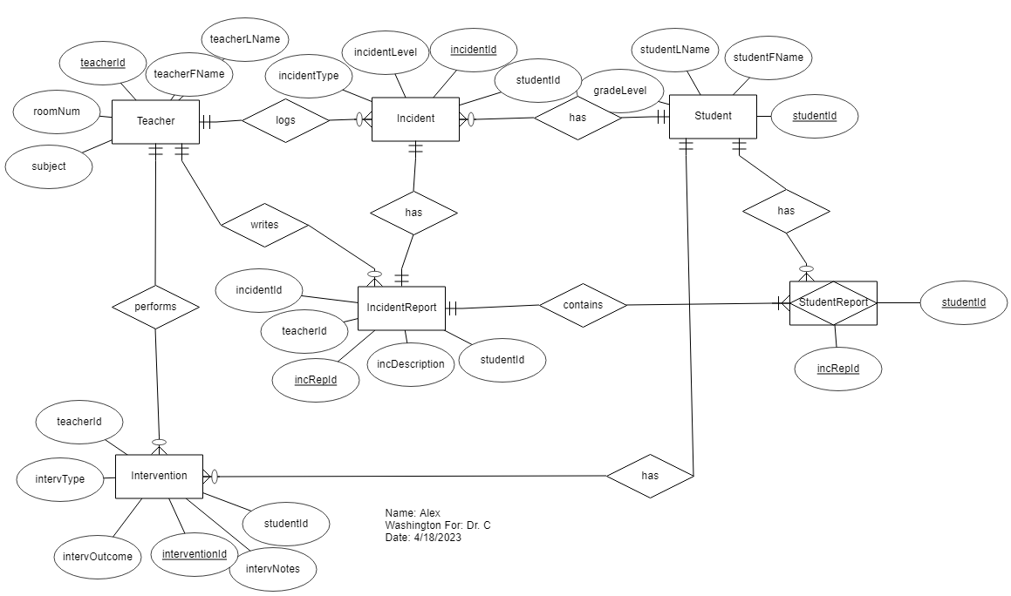

Er diagram

Slide 10
Database Summary
Overall, this project went well. The toughest part was figuring out which entities had relationships. It became easier to sort when it was clear that the student and teacher entities did not share a direct relationship. Rather, they were related to every other entity in the diagram.
Organizing the ER Diagram was a like a puzzle. The business rules helped me visualize how to show relationships. Other than organization and relationships, this project was fairly straightforward.

Slide 11
reference
Coronel, C., & Morris, S. (2018). Database Systems: Design, Implementation, & Management (13th ed.). Cengage Learning US. https://mbsdirect.vitalsource.com/books/9781337670562

